Slide 1
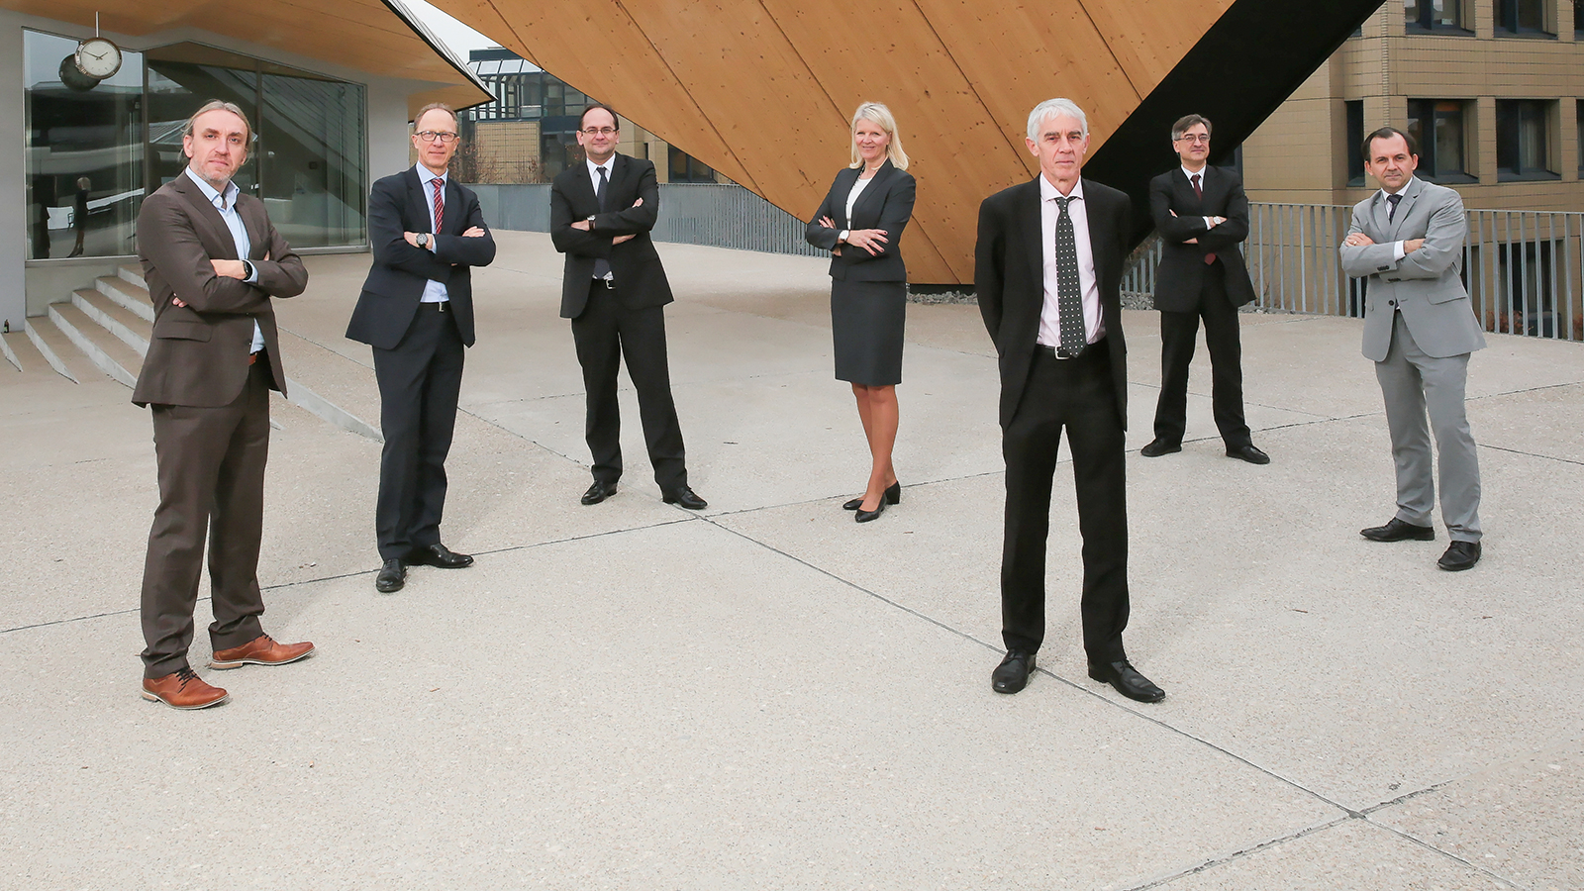
EPFL 2017 SENIOR MANAGEMENT
Andreas Mortensen
Vice President for
Research (VPR)
Marc Gruber
Vice President for Innovation (VPI)
Etienne Marclay
Edouard Bugnion
Vice President for Human Resources and Operations (VPRHO)
Caroline Kuyper
Vice President for Information Systems (VPSI)
Vice President for
Finances (VPFI)
Pierre Vandergheynst
Martin Vetterli
Vice President for Education (VPE)
President of EPFL

Slide 2
A new matrix structure
VPE
VPR
VPI
VPFI
Vice Presidency for
Finances
VPRHO
Vice Presidency for
Human Resources and Operations
VPSI
Vice Presidency for
Information Systems
Vice Presidency for Education
Vice Presidency for Research
Vice Presidency for Innovation

Slide 3
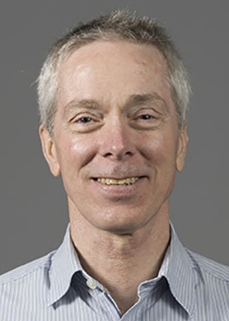
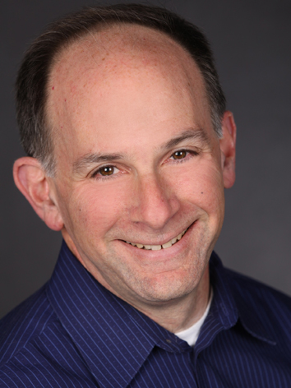
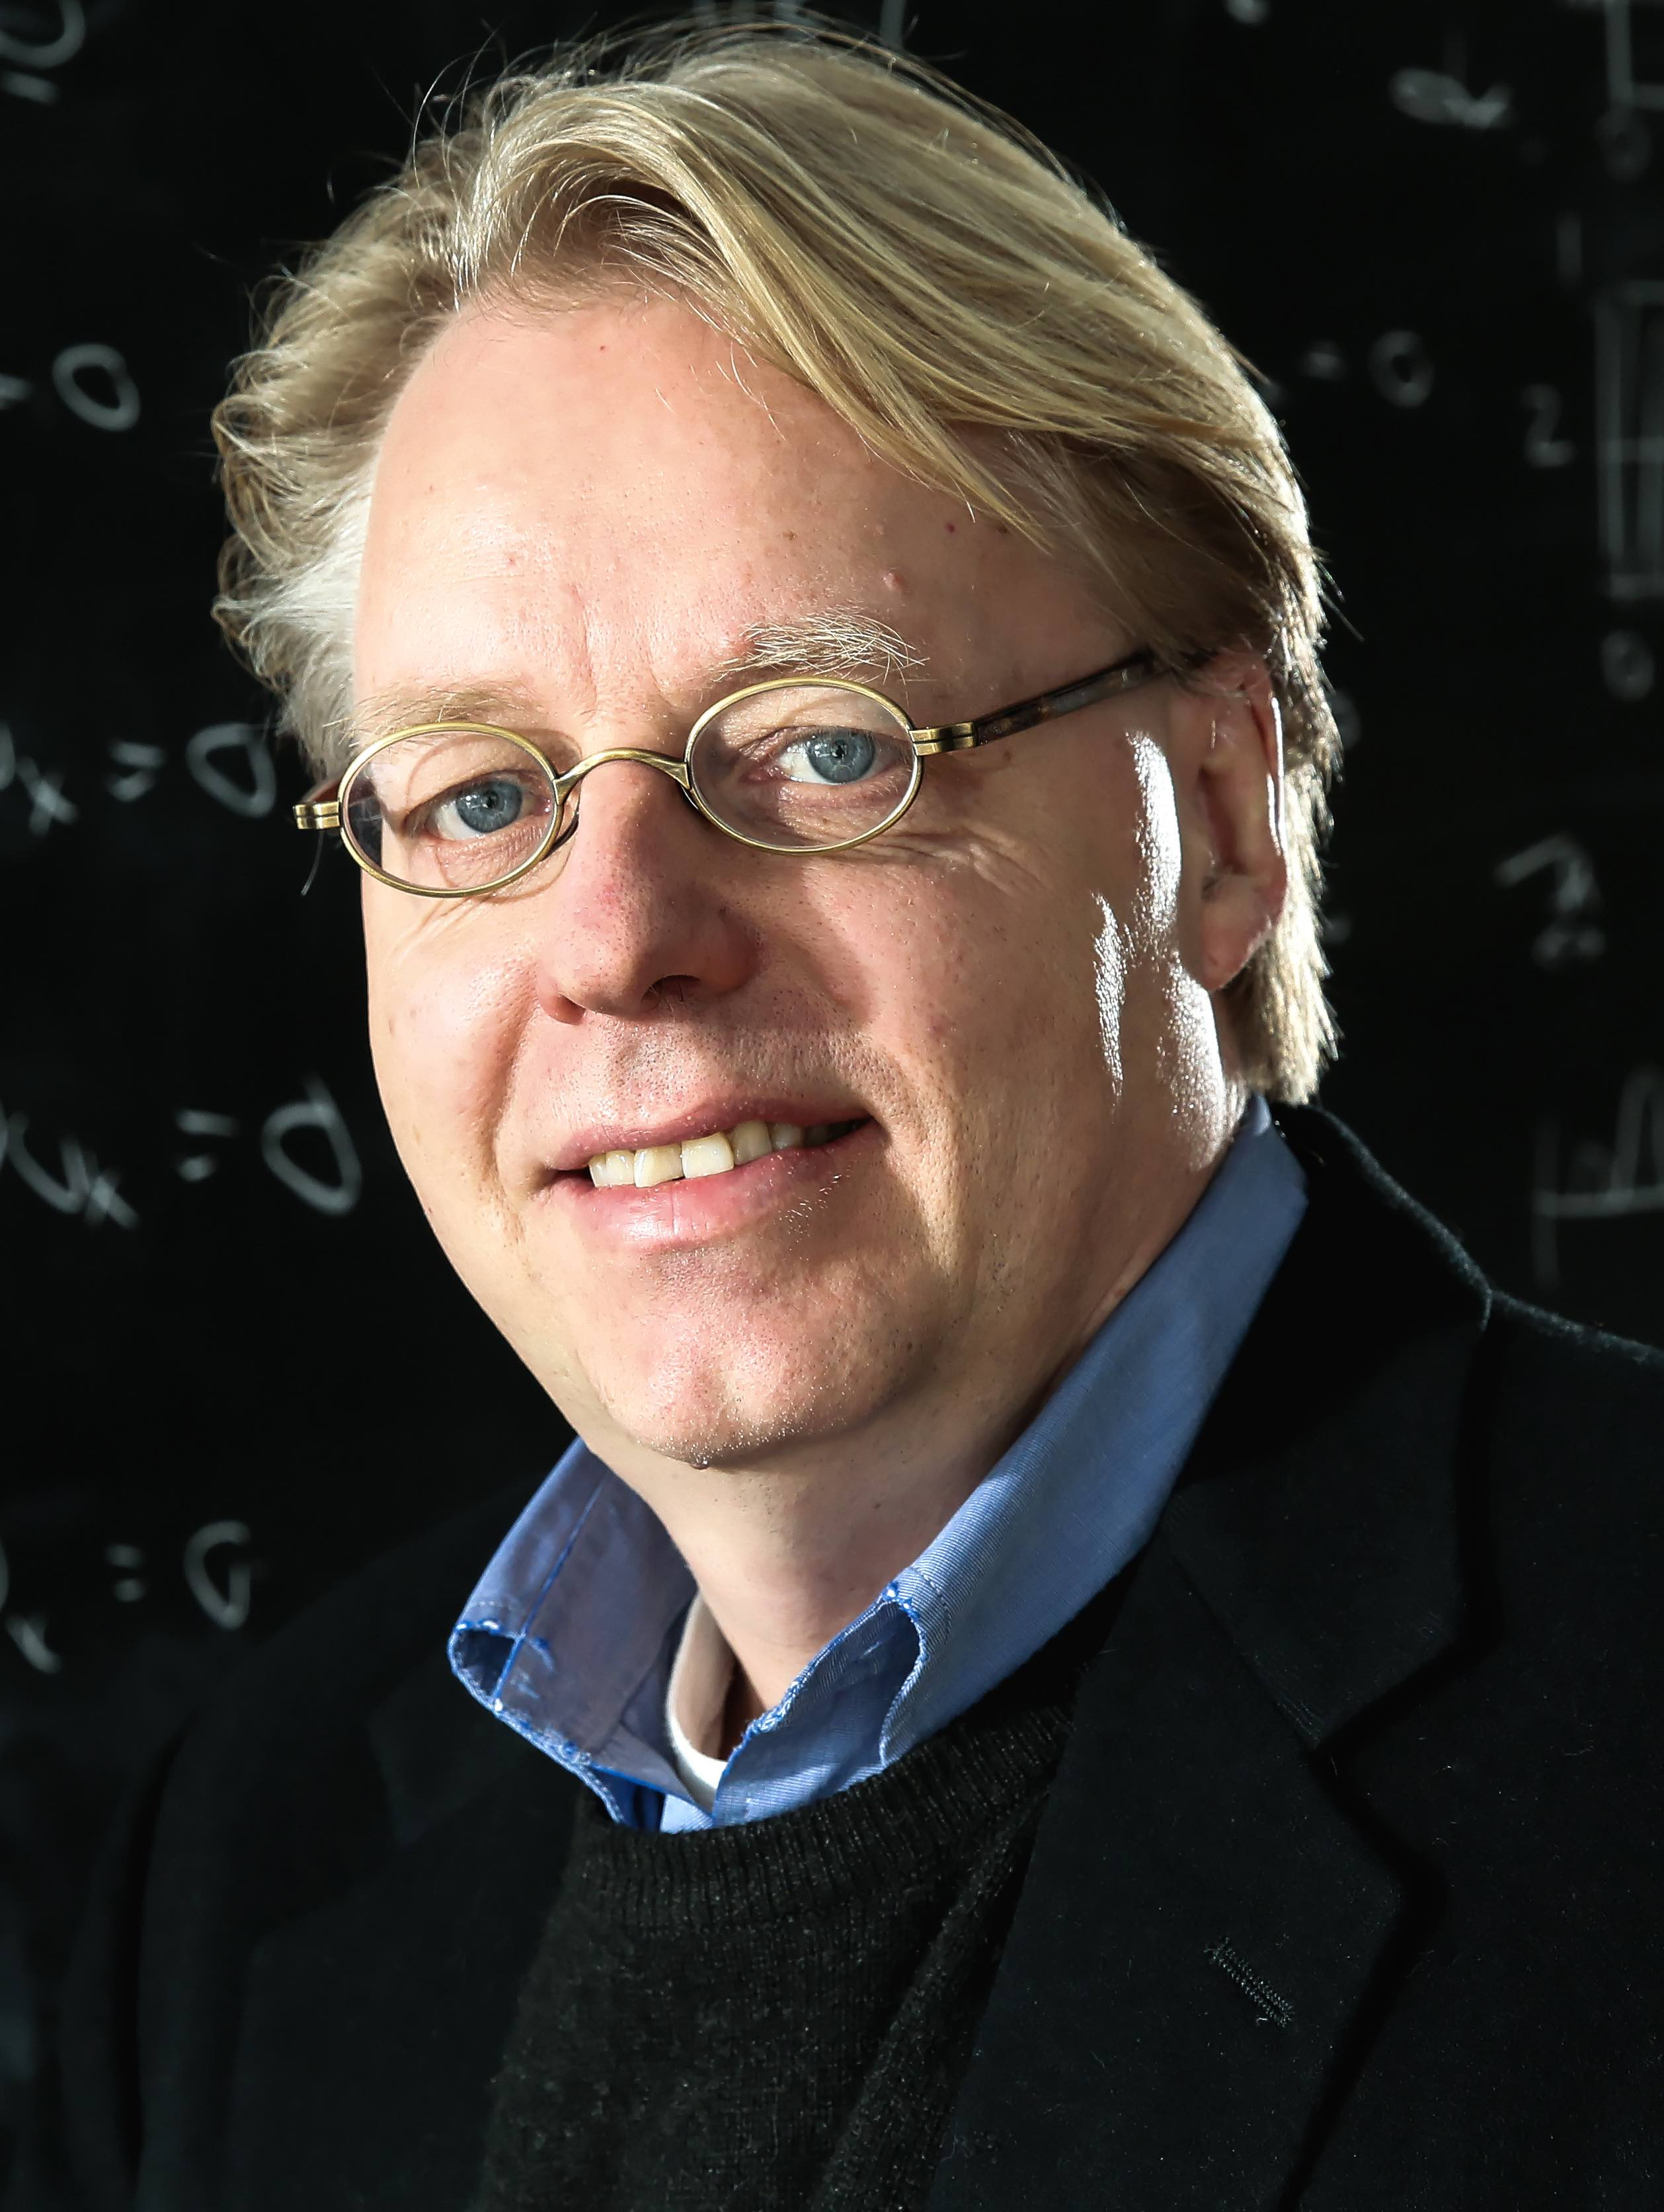
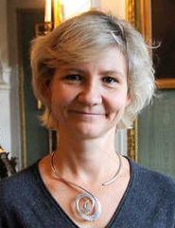
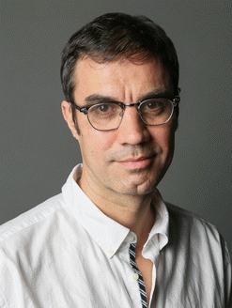
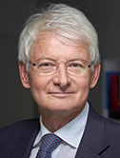
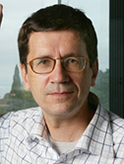
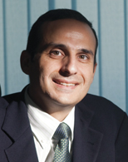
Deans of EPFL Schools
Interim Dean,
School of Architecture, Civil & Environmental Engineering
(ENAC)
Prof. Andrew Barry
Dean,
School of Computer & Communication Sciences
(IC)
Prof. Jim Larus
Dean,
School of Basic Sciences
(SB)
Prof. Jan Hesthaven
Dean,
School of Engineering (STI)
Prof. Ali H. Sayed
Dean,
School of
Life Sciences
(SV)
Prof. Gisou van der Goot
Director,
College of Humanities
(CDH)
Prof. Thomas David
Directors,
College of Management of Technology
(CDM)
Prof. Jean-Pierre Danthine
Prof. Dominique Foray
Dean,
EPFL Middle East
Franco Vigliotti

