Slide 1
Dialog 2025
45 min discussion between each school assembly committee and the ETH Board, June 11 at ETH and June 18 at EPFL
Aim
Initiate a real discussion and exchange
Raise awareness – give “insider” information to the external members
on issues regarding the domain, focusing on their role as advocates for the domain
on issues regarding one or both ETH, even if they concern the autonomy of the ETHs, to put pressure on the directions

Slide 2
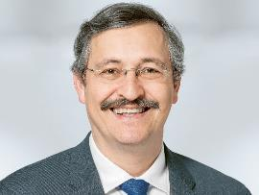
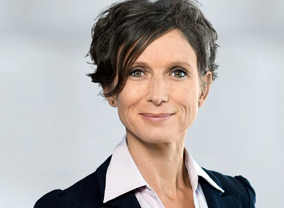
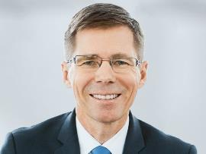

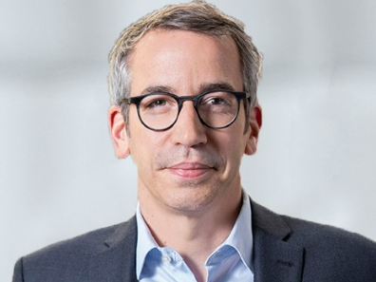
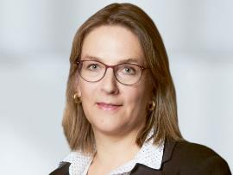
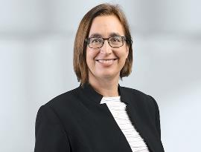
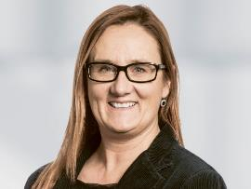
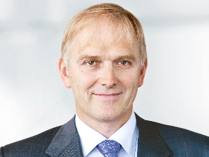


Composition of the ETH Board 2025
President and Vice-president
Michael Hengartner
Pascale Bruderer
«Internal» members
& members of staff
Joël Mesot, ETH
Anna Fontcuberta, EPFL
Christian Ruegg, PSI
Kristin Becker, School Assemblies
Independent members («external»)
Cornelia Ritz Bossicard,
President of Audit Committee
Beatrice Fasana
Marc Bürki
Susan Gasser
Christiane Leister

Slide 3
Dialog: exchange school assemblies - ETH Board
Year | Transversal theme* | Themes ETH Zurich | Themes EPFL
2018 | Doctoral students (recruitment, supervision support, handling of problematic situations) | Dealing with misconduct, role of HV in relation to ETH Board | -
2019 | Doctoral students (recruitment, supervision support, handling of problematic situations) | Leadership in general, Growth, Sustainability | Sustainable campus
2020 | Sustainability in education | Covid-19 measures | Covid-19 crisis
2021 | Diversity and inappropriate behaviour | Growth, Post-Covid | Participation, Growth
*Common transversal theme since 2018

Slide 4
Dialog: exchange school assemblies - ETH Board
Year | Transversal theme | Themes ETH Zurich | Themes EPFL
2022 | Follow-up of the previous Dialog Meetings: How has the ongoing organisational development and leadership culture to be adapted to enable the institutions to adequately address important Dialog themes of the last years, i.e. a) positioning of the ETH Domain in sustainability, b) participation, c) diversity & inclusiveness and d) growth in student numbers? What would be the appropriate supportive measures? | Horizon Europe und Erasmus+, differences in the handling of home office between federal staff and the ETH domain | Europe
2023 | Growth of ETH Zurich and EPFL with stable budget and increasing costs: how to maintain excellent education, research & innovation? How do you advise us to manage the growth pressure under the current and upcoming budget constraints? From the point of view of the external ETH Board members, what societal, political and cultural changes would we need in Switzerland to tackle this problem? | Wie lässt sich verantwortliches Handeln ohne eine starke Zunahme an Regularien und Bürokratie erreichen? | -

Slide 5
Dialog: exchange school assemblies - ETH Board
Year | Transversal theme | Themes ETH Zurich | Themes EPFL
2024 | How to preserve or increase the quality of ETH & EPFL and attract the best, despite worsening conditions? Topics possibly included: Horizon Europe, mental health, sustainability & climate challenges, no increase in budget from Confederation, increase in living costs (student housing, public transport, health insurance), AI & ethics in teaching & research, culture & communication and leadership culture | - | -

Slide 6
Dialog 2025
The ETH Board will focus the topics for the Dialogs 2025 and 2026 on the prioritized action lines from the interim evaluation 2023.
Action lines from the interim evaluation 2023 prioritized by ETH Board, as decided in May 2024:
Rec. 1 Quality and relevance of education
1st action line: The institutions of the ETH Domain pay particular attention to assessing the relevance of educational programmes in terms of the present and future demands of the economy, industry, research and the public sector. A focus is placed on types of interaction with future employers and tools for assessing the relevance of learning outcomes.
Rec. 2 Quality in a context of growth in student numbers
1st action line: The institutions of the ETH Domain give the highest priority to research-based teaching and continue to take the necessary action to maintain and improve the quality of education in the long term.
Rec. 5 Attractiveness of the institutions of the ETH Domain
2nd action line: The ETH Board and the institutions of the ETH Domain further strengthen their leading role in conceptualising, developing, operating and upgrading large-scale research infrastructures and large, interdisciplinary platforms. They take into account the long-term needs of the scientific community and ensure long-term stable funding through strategic decisions and prioritisation.

Slide 7
Dialog 2025
Rec. 7 Knowledge and technology transfer
1st action line: The institutions of the ETH Domain are further strengthening their key role in knowledge and technology transfer (KTT) for the benefit of the economy (young companies as well as SMEs and established companies), the public sector and society.
2nd action line: They continuously develop their KTT instruments to enable simple and straightforward processes, while ensuring a proper balance of interests.
Rec. 8 Internal structure of the ETH Domain
1st action line: The ETH Board, together with the institutions of the ETH Domain, evaluates various options on how to best position and organise the ETH Domain to meet future needs.
Rec. 11 Diversity and inclusion
1st action line: The ETH Board and the institutions of the ETH Domain build on existing policies to develop and implement a strategy for diversity, inclusion and equity based on a culture of respect.
Rec. 16 Dialogue with society
1st action line: The institutions of the ETH Domain are intensifying the dialogue between academic actors, public authorities and society and are becoming involved in relevant debates at an early stage in order to respond promptly to urgent challenges. They play a leading role in the development and implementation of the strategies to improve the involvement of the scientific community in future crisis situations.

Slide 8
Dialog 2025
Proposals from 2023
Future of education - AI
Ethics in teaching and research
Proposals from Committee HV ETH (discussion on 31.10.24)
Lack of funding for the ETH domain and SNSF and its impact on quality –> importance of clearly demonstrating the needs of ETH & EPFL
Impact of increase of tuition fees on attractiveness and diversity (link with actions lines for recommendations 2 (quality in context of growing student numbers), 5 (attractiveness) and 11 (diversity and inclusion)

Slide 9
Dialog 2025
Transversal theme defined at common HV/AE meeting on Nov. 5, 2024:
-> Impact of tuition fee increase and of budget cuts on attractiveness, diversity, academic excellence and Switzerland’s leading position in innovation
Link with actions lines regarding recommendations 2 (quality in context of growing student numbers) and 5 (attractiveness) and 11 (diversity and inclusion).
Discussion points:
Give examples of consequences of the budget cuts (no salary increase, less funds for apprentice support, no more Cybatholon, other programs and events no longer take place, no more bachelor thesis in some curricula, etc. ).
Risk that income from higher tuition fees, which is negligeable, will have to be used for more administration and accompanying measures (e.g. social scholarships).
Increase of tuition could be even higher if the recommendation from the Gaillard report is implemented.
Impact on sustainability and education – context of global changes, geopolitical situation, etc.
Impact on outreach activities – consequences on image

