Slide 1
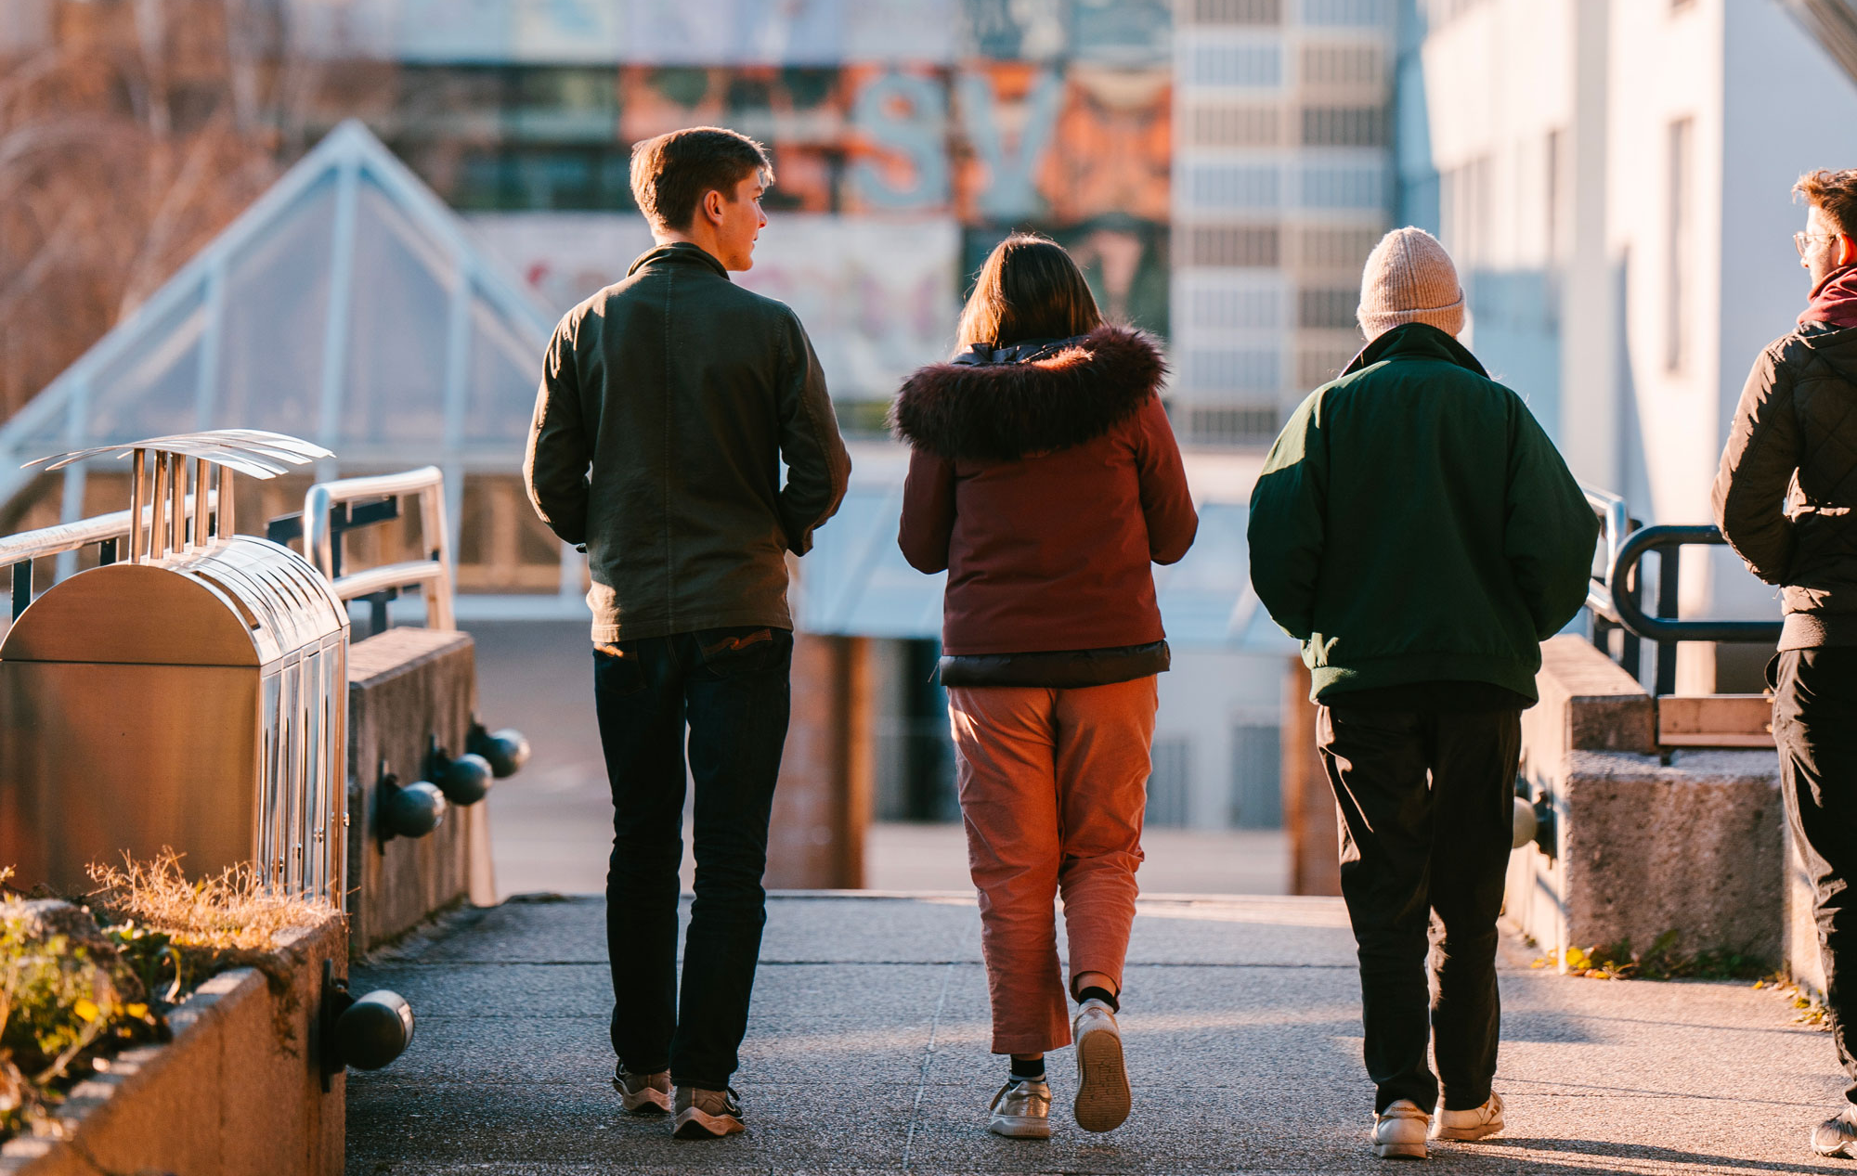
EPFL ASSEMBLY
2024: Transition in Continuity
Martin Vetterli
EPFL President
EPFL – BC 410
02.02.2024

Slide 2
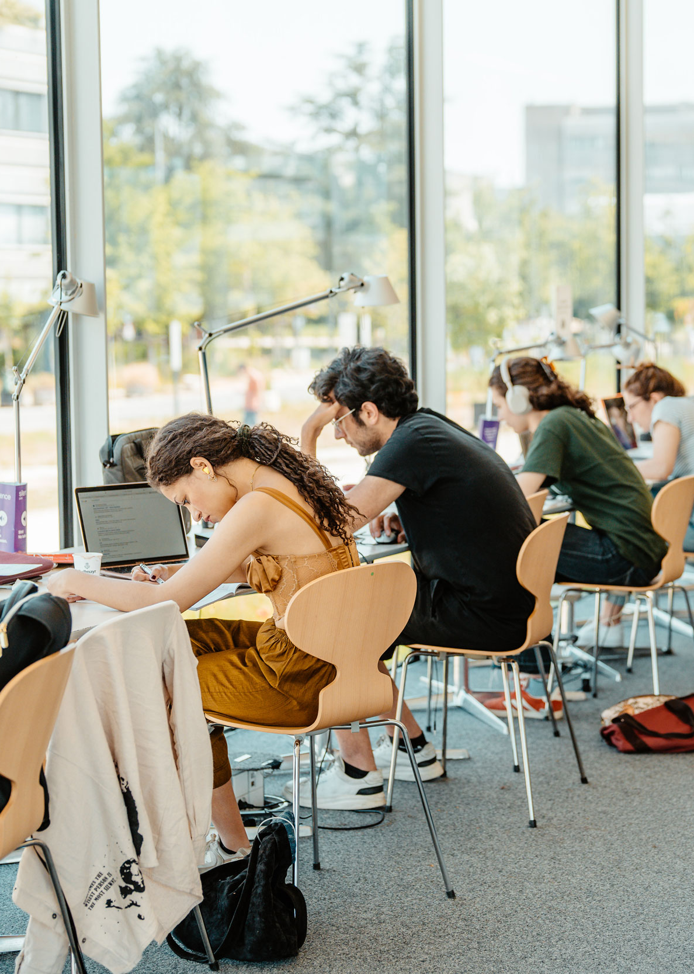
Education
Research
Innovation
Culture
Budget
OUTLINE

Slide 3
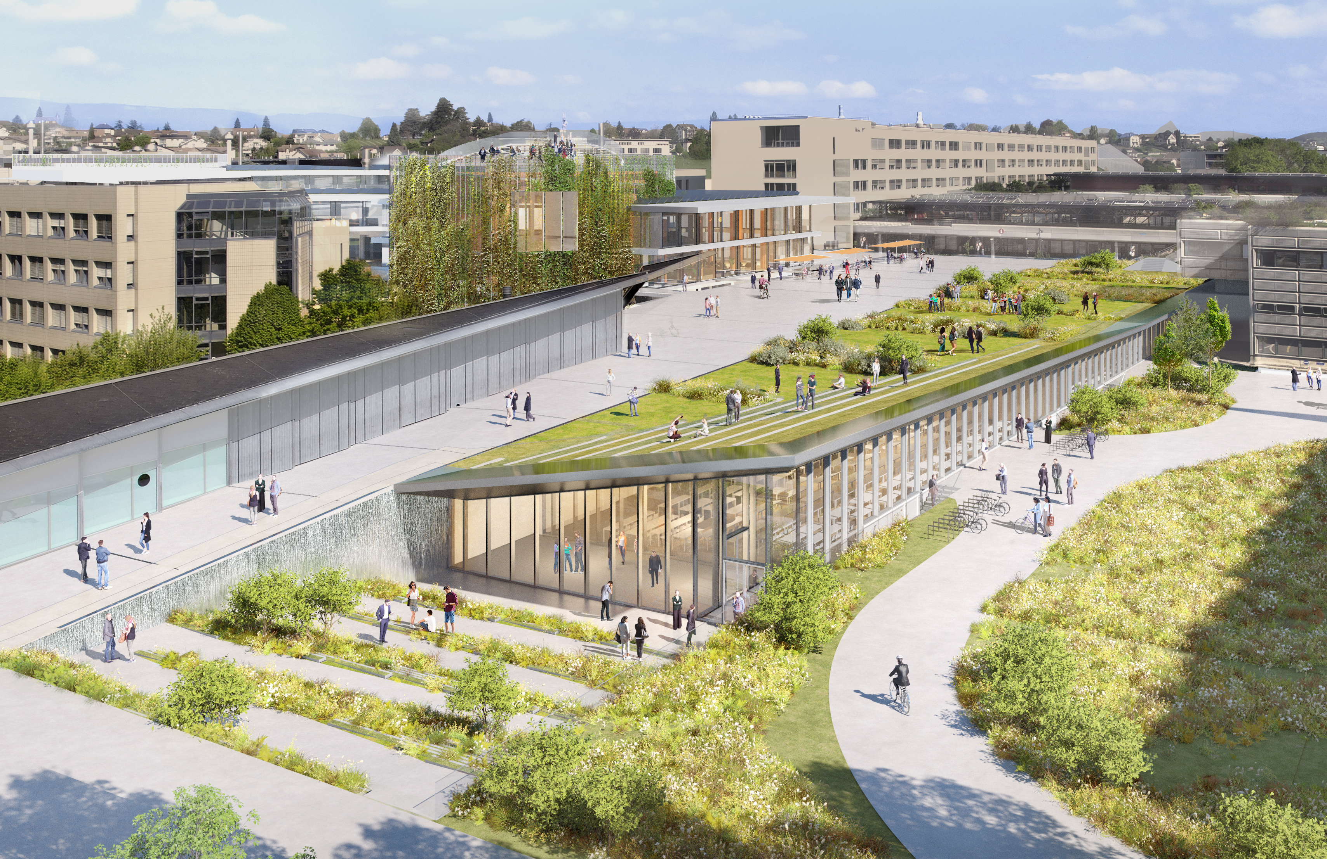
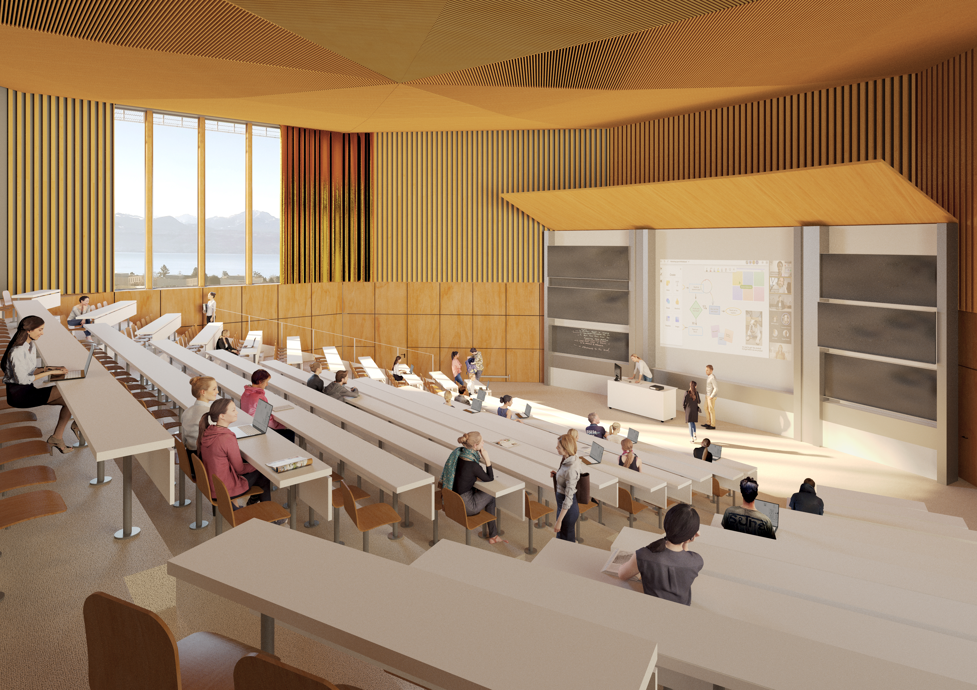
Education
Our biggest challenge remains the growing students numbers, and our multifaceted initiatives to cope with it.
Initiatives:
  We hold consultation to limit the growth in Bachelor's students: admitted each year at 3,000
  Renovation Esplanade-Coupole with “Double Deck”
  New auditoria (1500 seats)

Slide 4
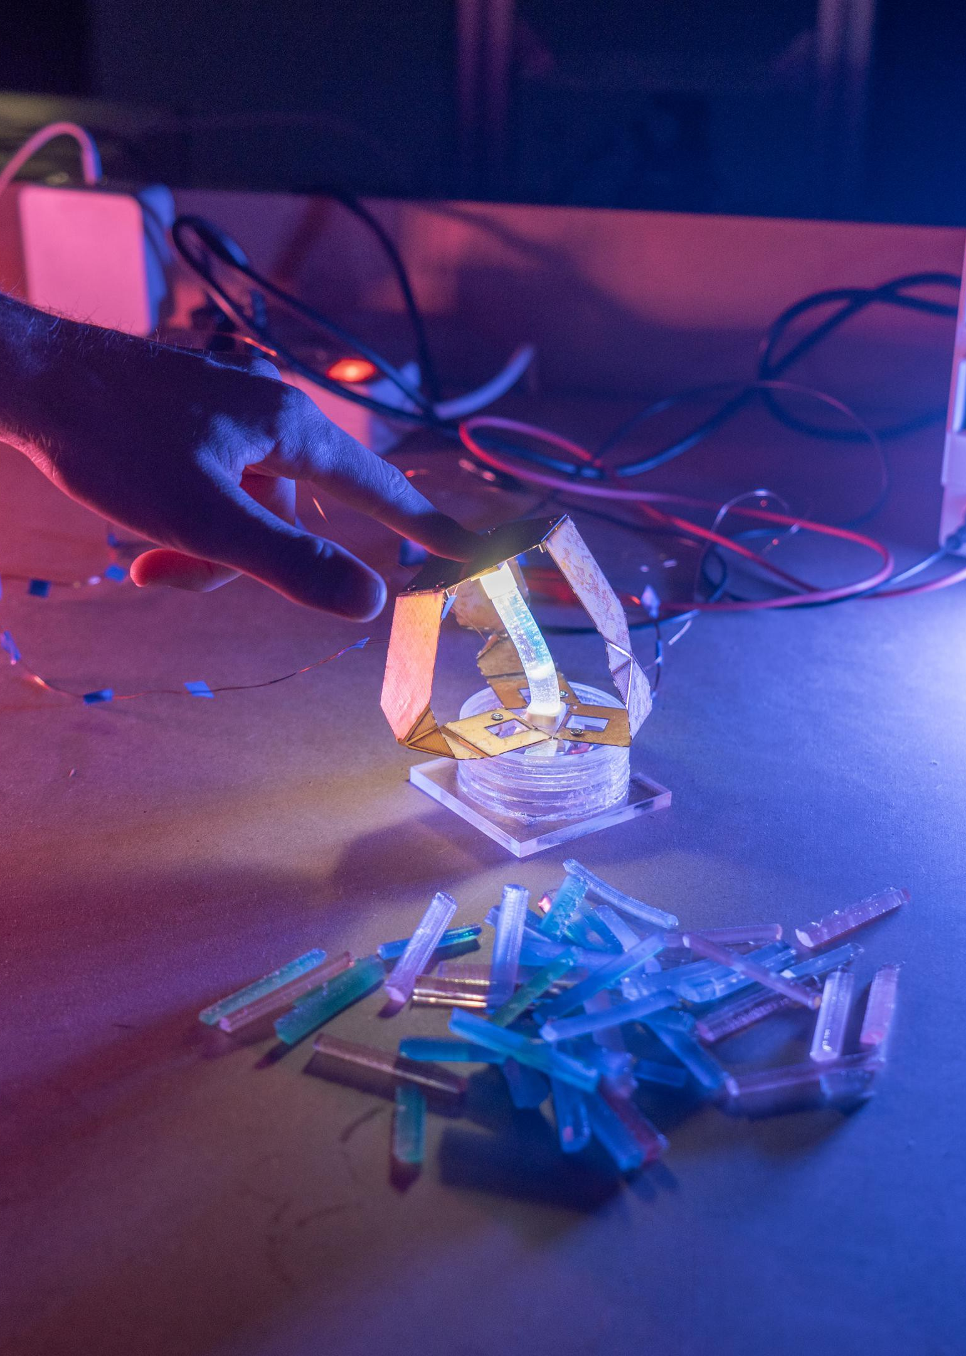
Education
Research
Innovation
Culture
Budget
OUTLINE
Notes:
Photo: https://actu.epfl.ch/news/a-color-based-sensor-to-emulate-skin-s-sensitivi-2/

Slide 5
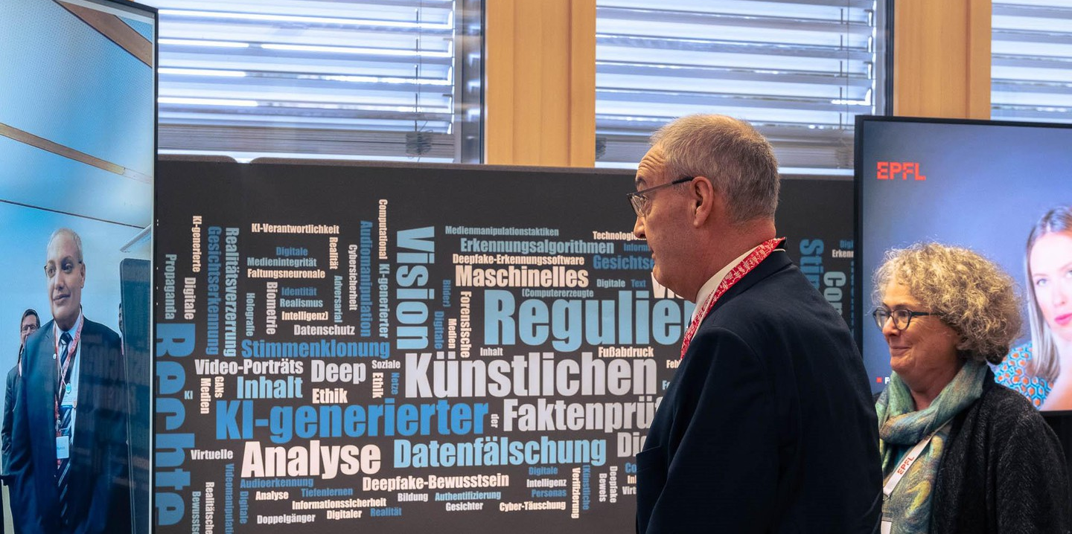
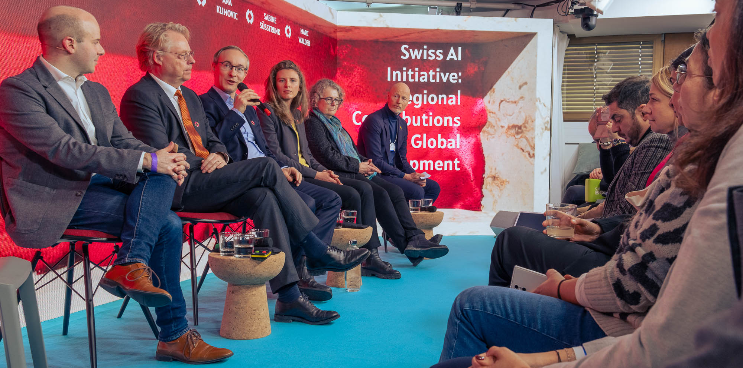
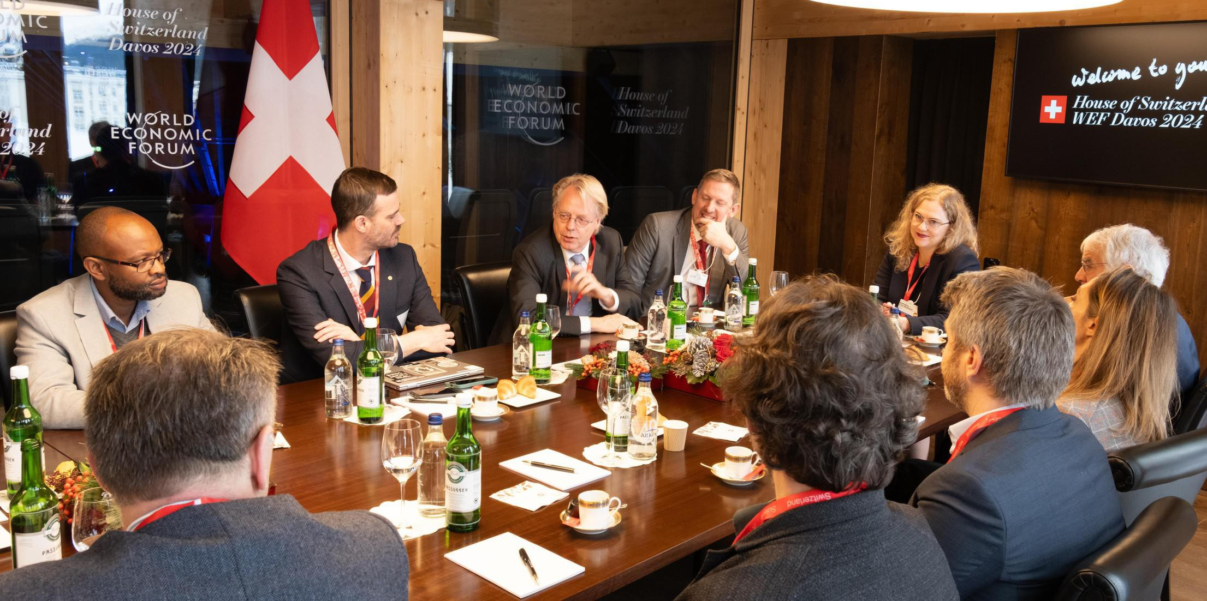

AI and deepfakes on show at Davos
Deepfakes at WSL
Swiss AI Initiative
International Computation and AI Network
Launch of a Pilot Gen AI Redteaming network
Notes:
Among the global powerbrokers at this year’s annual World Economic Forum in Davos many were interested in the fast-moving opportunities and challenges of artificial intelligence and EPFL was a key player among the action.
Hosted at Davos by the WSL Institute for Snow and Avalanche Research SLF, EPFL researchers from Professor Sabine Süsstrunk’s Image and Visual Representation Laboratory (IVRL) offered WEF delegates, including Switzerland’s Federal Councillor Guy Parmelin, the opportunity to experience being deepfaked first hand, as well as learn about how EPFL is working on their detection.
One new partnership on display was the Swiss AI Initiative, a pooling together of Swiss research resources in AI on a national level, including the EPFL and ETH Zurich AI Centers, for Swiss AI sovereignty. The Initiative will position Switzerland as a leading global hub for the development and implementation of transparent and reliable artificial intelligence. The new ALPS supercomputer, based at the Swiss National Supercomputing Centre is providing the supporting world-class infrastructure. It’s one of the world’s most powerful computers and gives Swiss scientists access to the sort of computing power only available to the world’s biggest tech companies.
Another joint initiative announced at Davos, led by the Swiss Federal Department of Foreign Affairs, EPFL and ETH Zurich is the Pilot Gen AI Redteaming Network, that aims to unite tech leaders, AI experts, and policymakers in exploring AI safety testing and risk management. Professor Carmela Troncoso, Head of IC’s Security and Privacy Engineering Lab (SPRING) is one of the academic leads for the Swiss Call for Trust and Transparency in AI which is leading the Pilot Gen AI Redteaming Network that will see researchers work with the giants of AI, including: Microsoft, IBM, Google, Amazon, AlephAlpha and HuggingFace.
Also launched at the World Economic Forum by the Swiss Federal Department of Foreign Affairs, EPFL and ETHZ was the International Computation and AI Network (ICAIN) to develop AI technologies that will be sustainable, accessible to all and benefit society as a whole, contributing to the UN’s Global Goals.

Slide 6




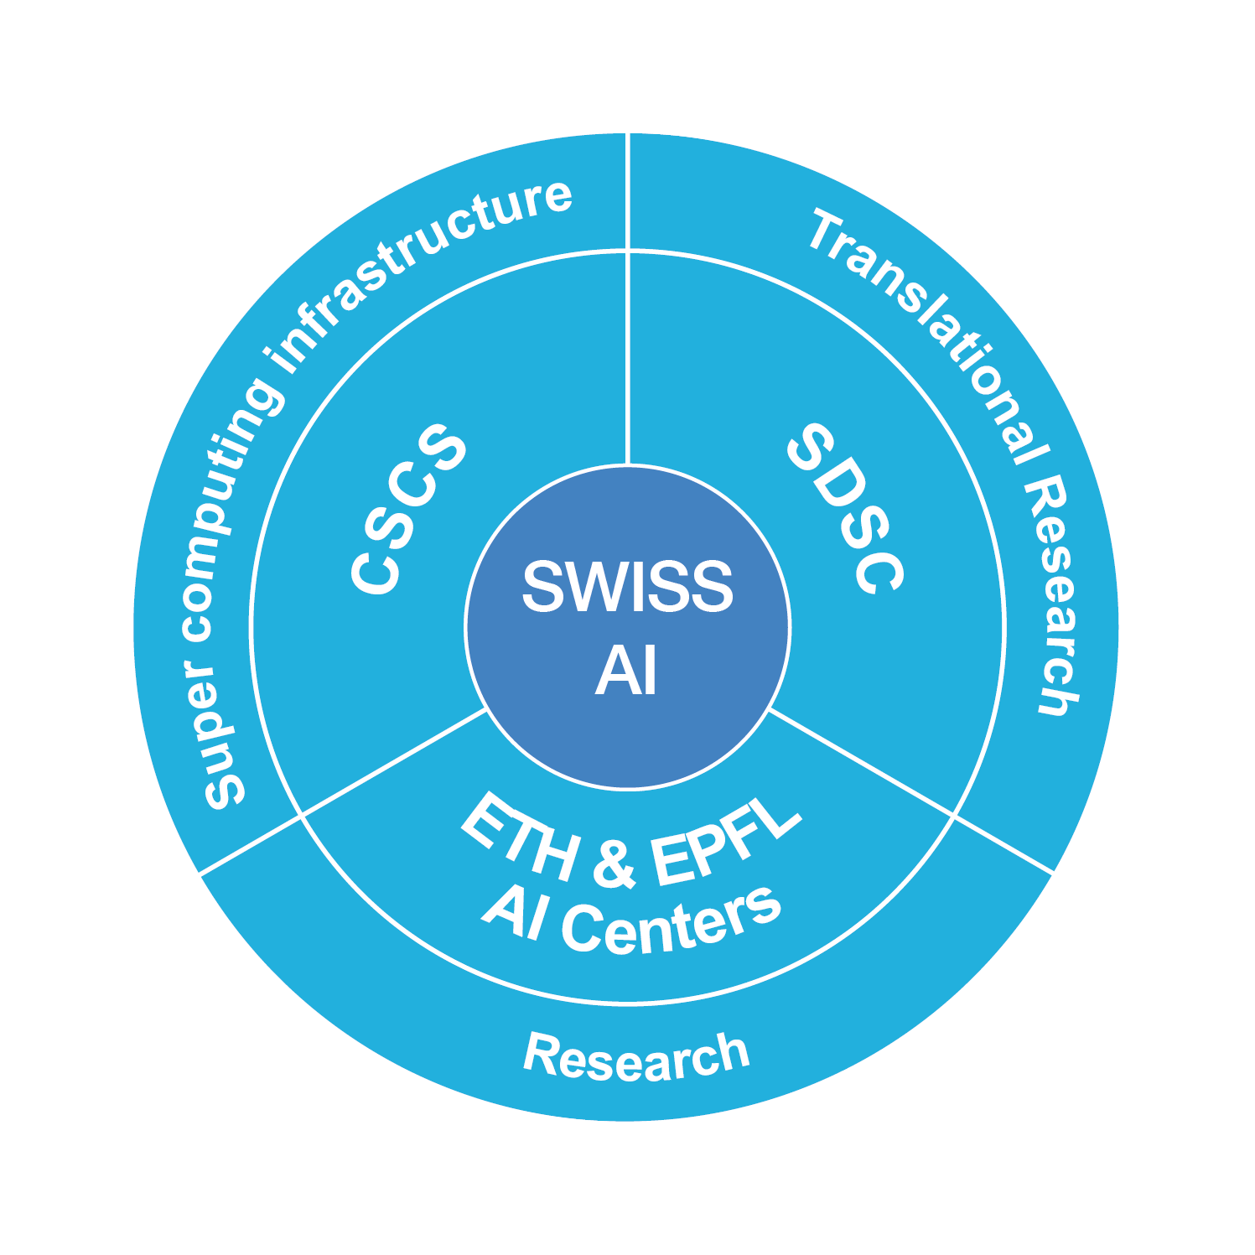


Swiss Ai Intiative and SDSC
The SwissAI initiative is absolutely critical, and while still in the birthing stage, the fact that the ETH domain has probably the largest academic cluster (10’000 GPUs) put us in a very powerful and attractive position.
The SDSC and its placement within the ETH domain is moving forward rather smoothly.

Slide 7
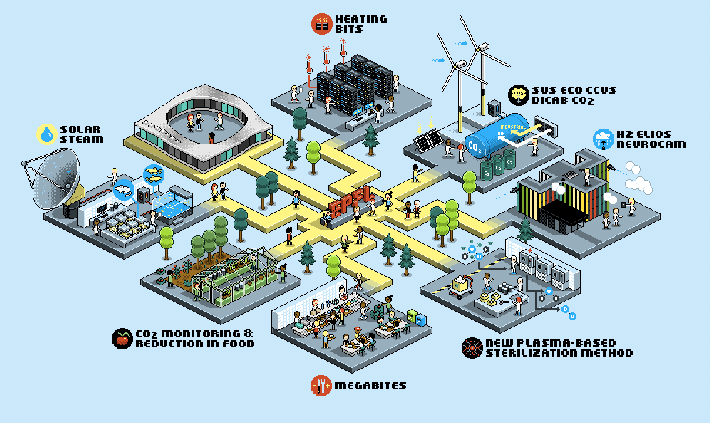
Sustainability
On solutions for sustainability (S4S), we are in a strong position, also for the national CGES initiative.
Our internal organisation around both AI and S4S (cluster on climate, energy and and sustainability, CES) is adapting nicely.

Slide 8
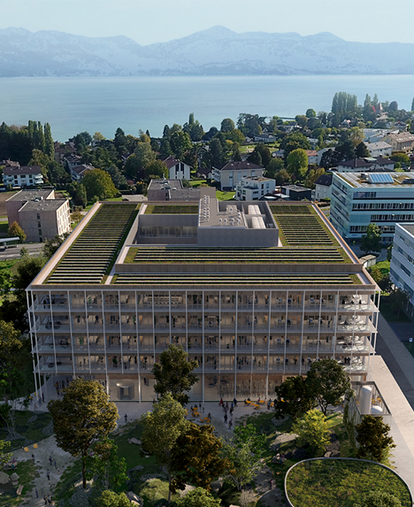
Advanced Science Building
A building to explore new frontiers
  Only one possible location (EMI, vibrations)
  Very low perturbation environments
  Research platforms, labs, working spaces
  500+ users
Process
  EPFL Scientific Committees
  13 candidates, 2 finalists
  A jury of 50 experts, specialists (int. & ext.)
  Laureate : Group led by Kaan + Celnikier & Grabli Arch.
Next steps
  A contract in preparation
  Review by Parliament (Fall 2025, for 2026)
  Construction expected : 2026-2029

Slide 9
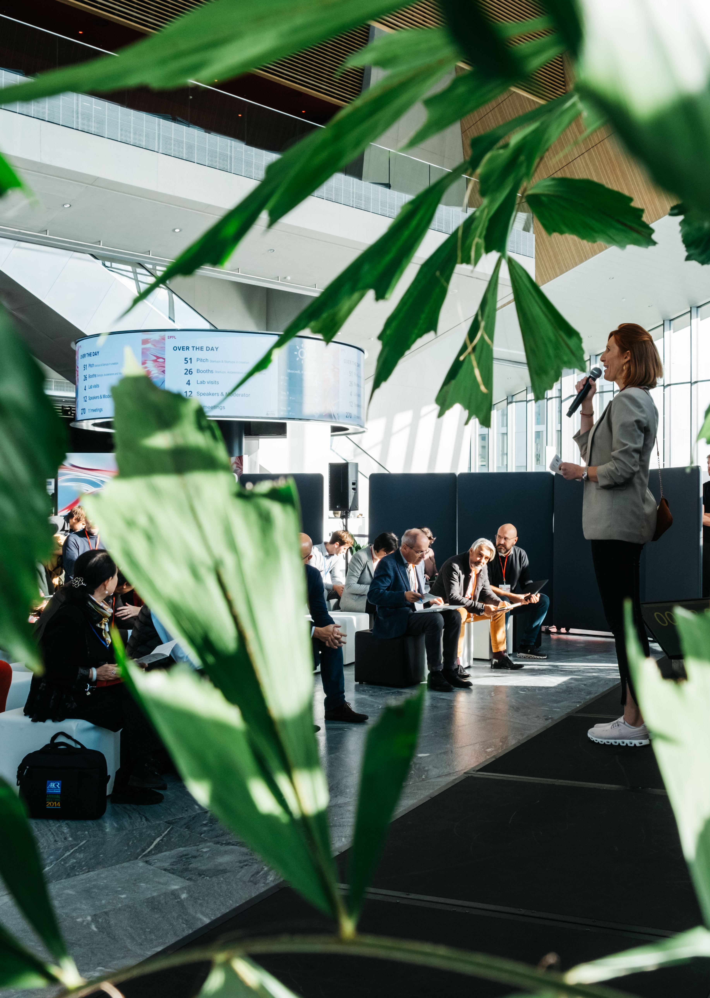
Education
Research
Innovation
Culture
Budget
OUTLINE
Notes:
Photo: https://actu.epfl.ch/news/a-color-based-sensor-to-emulate-skin-s-sensitivi-2/

Slide 10





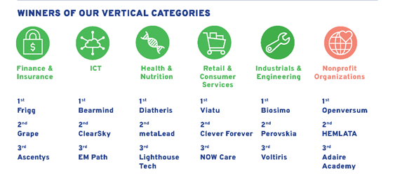
Startups at EPFL in 2023
21
470
27 EPFL startups in the TOP100
Swiss Startup Award 2023
New startups
4 in TOP10
MCHF raised
6
16
STARTUPS 2024
Venture Competition 2023 winners
Scale-up rounds
(+20MCHF)
Early stage rounds (1MCHF<5MCHF)
6
New startups in
Cleantech/Environment

Slide 11

Education
Research
Innovation
Culture
Budget
OUTLINE
Notes:
Photo: https://actu.epfl.ch/news/a-color-based-sensor-to-emulate-skin-s-sensitivi-2/

Slide 12

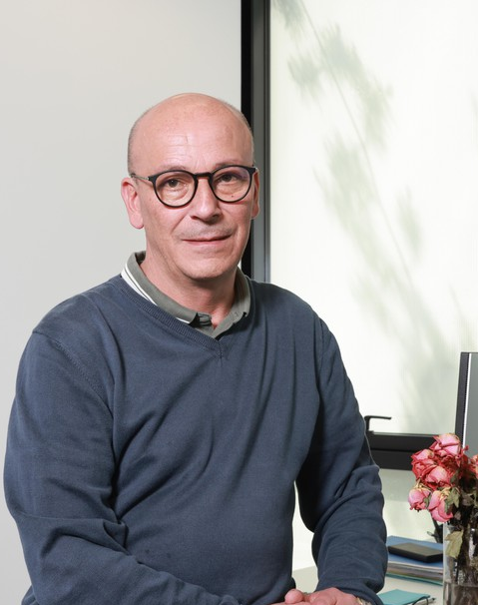
Culture
We have made impressive progress, but we are not at the end of the journey, so we need to keep up the momentum and the good work!
Health Days 2023 with Service Sport Santé UNIL-EPFL
One-week break in the autumn semester from 2024
Trust point – the entry point to the Trust & Support Network, and for questions related to psychosocial risks
New Respect Compliance Officer
NEW Respect Compliance Officer: Emmanuel Noyer
Notes:
Leur succès ne peut cependant pas faire oublier les conclusions de l’enquête sur la santé mentale et le bien-être de la communauté EPFL : ses résultats publiés en 2023 indiquent notamment de préoccupants niveaux d’épuisement, surtout au niveau du corps étudiant, ainsi qu’une hausse des comportements négatifs relevant du bullying/mobbing envers les doctorantes et doctorants.
Des actions concrètes, comme l’évolution des Jours Santé co-organisés avec le Service Sport Santé UNIL-EPFL ou l’introduction dès 2024 d’une semaine de pause au semestre d’automne, ont déjà été mises en place pour répondre en partie à ces problématiques.
La consolidation en 2023 du dispositif lié aux risques psychosociaux à l’EPFL ne résoudra pas toutes les difficultés d’un coup de baguette magique. Mais là encore, l’École essaie de tester des choses, en mettant davantage en réseau les professionnels du soutien, avec de nouvelles formations, de nouveaux outils (Trust point par exemple, https://trust-point.epfl.ch/fr/) , de nouvelles fonctions dédiées (comme le Respect Compliance Officer, https://www.epfl.ch/about/respect/fr/respect-compliance-office).

Slide 13

Education
Research
Innovation
Culture
Budget
OUTLINE
Notes:
Photo: https://actu.epfl.ch/news/a-color-based-sensor-to-emulate-skin-s-sensitivi-2/

Slide 14
Measures decided
New and replacement hiring subject to approval
Special bonuses cancelled
Reduction in the financial contribution to units that hire apprentices
Ending our sponsorship of the Forum des 100
Reduction in office cleaning
Reduction in standard furniture provision
Abolition of payment of vacation balance at end of contract
DLL MX project on hold
Optimization of software licenses
Reducing nitrogen use in labs
Reducing the budget for upgrading IS Academia and servicing current versions of SAP
Notes:
List a few efforts done since the townhall

Slide 15
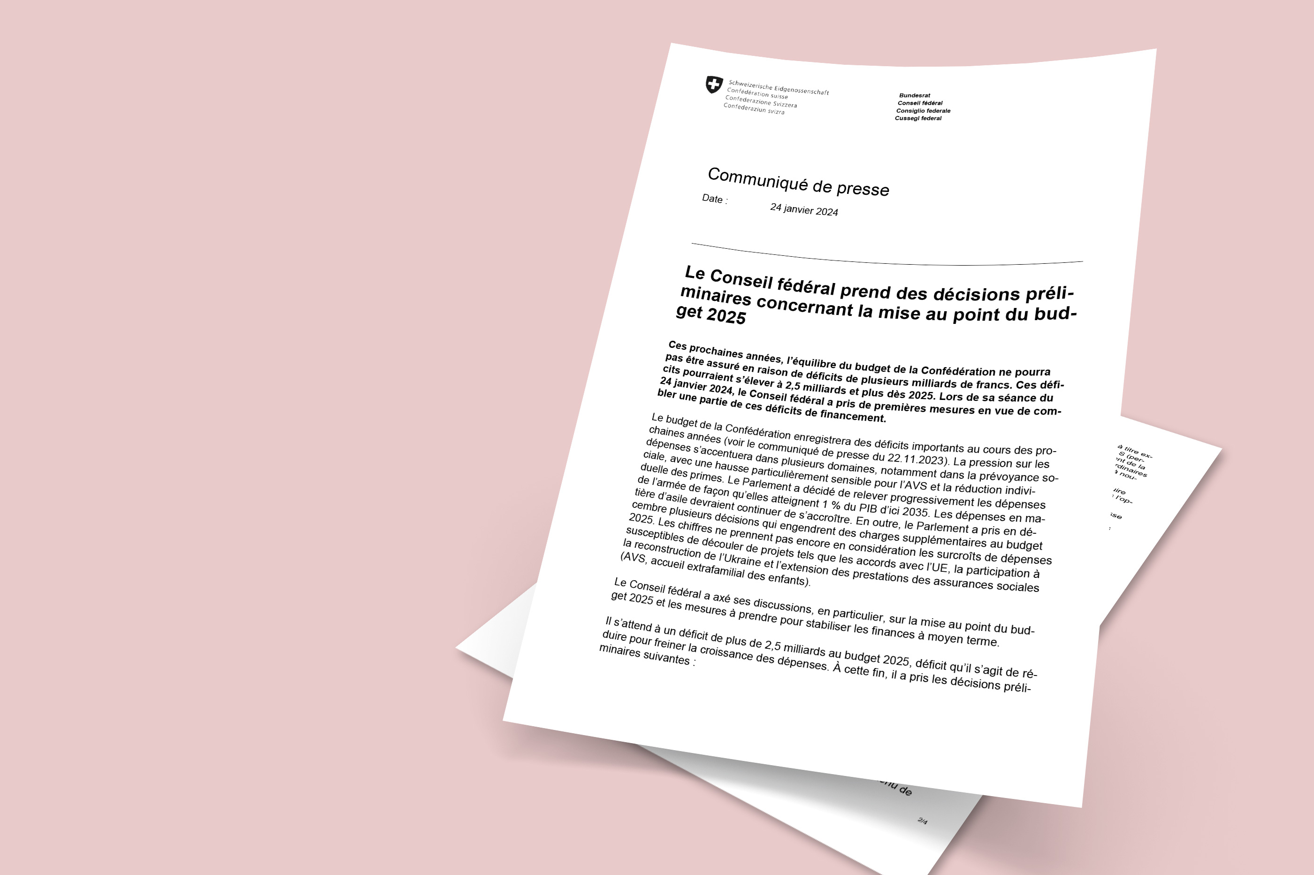
Press release from Federal Council 24.01.2024

Slide 16
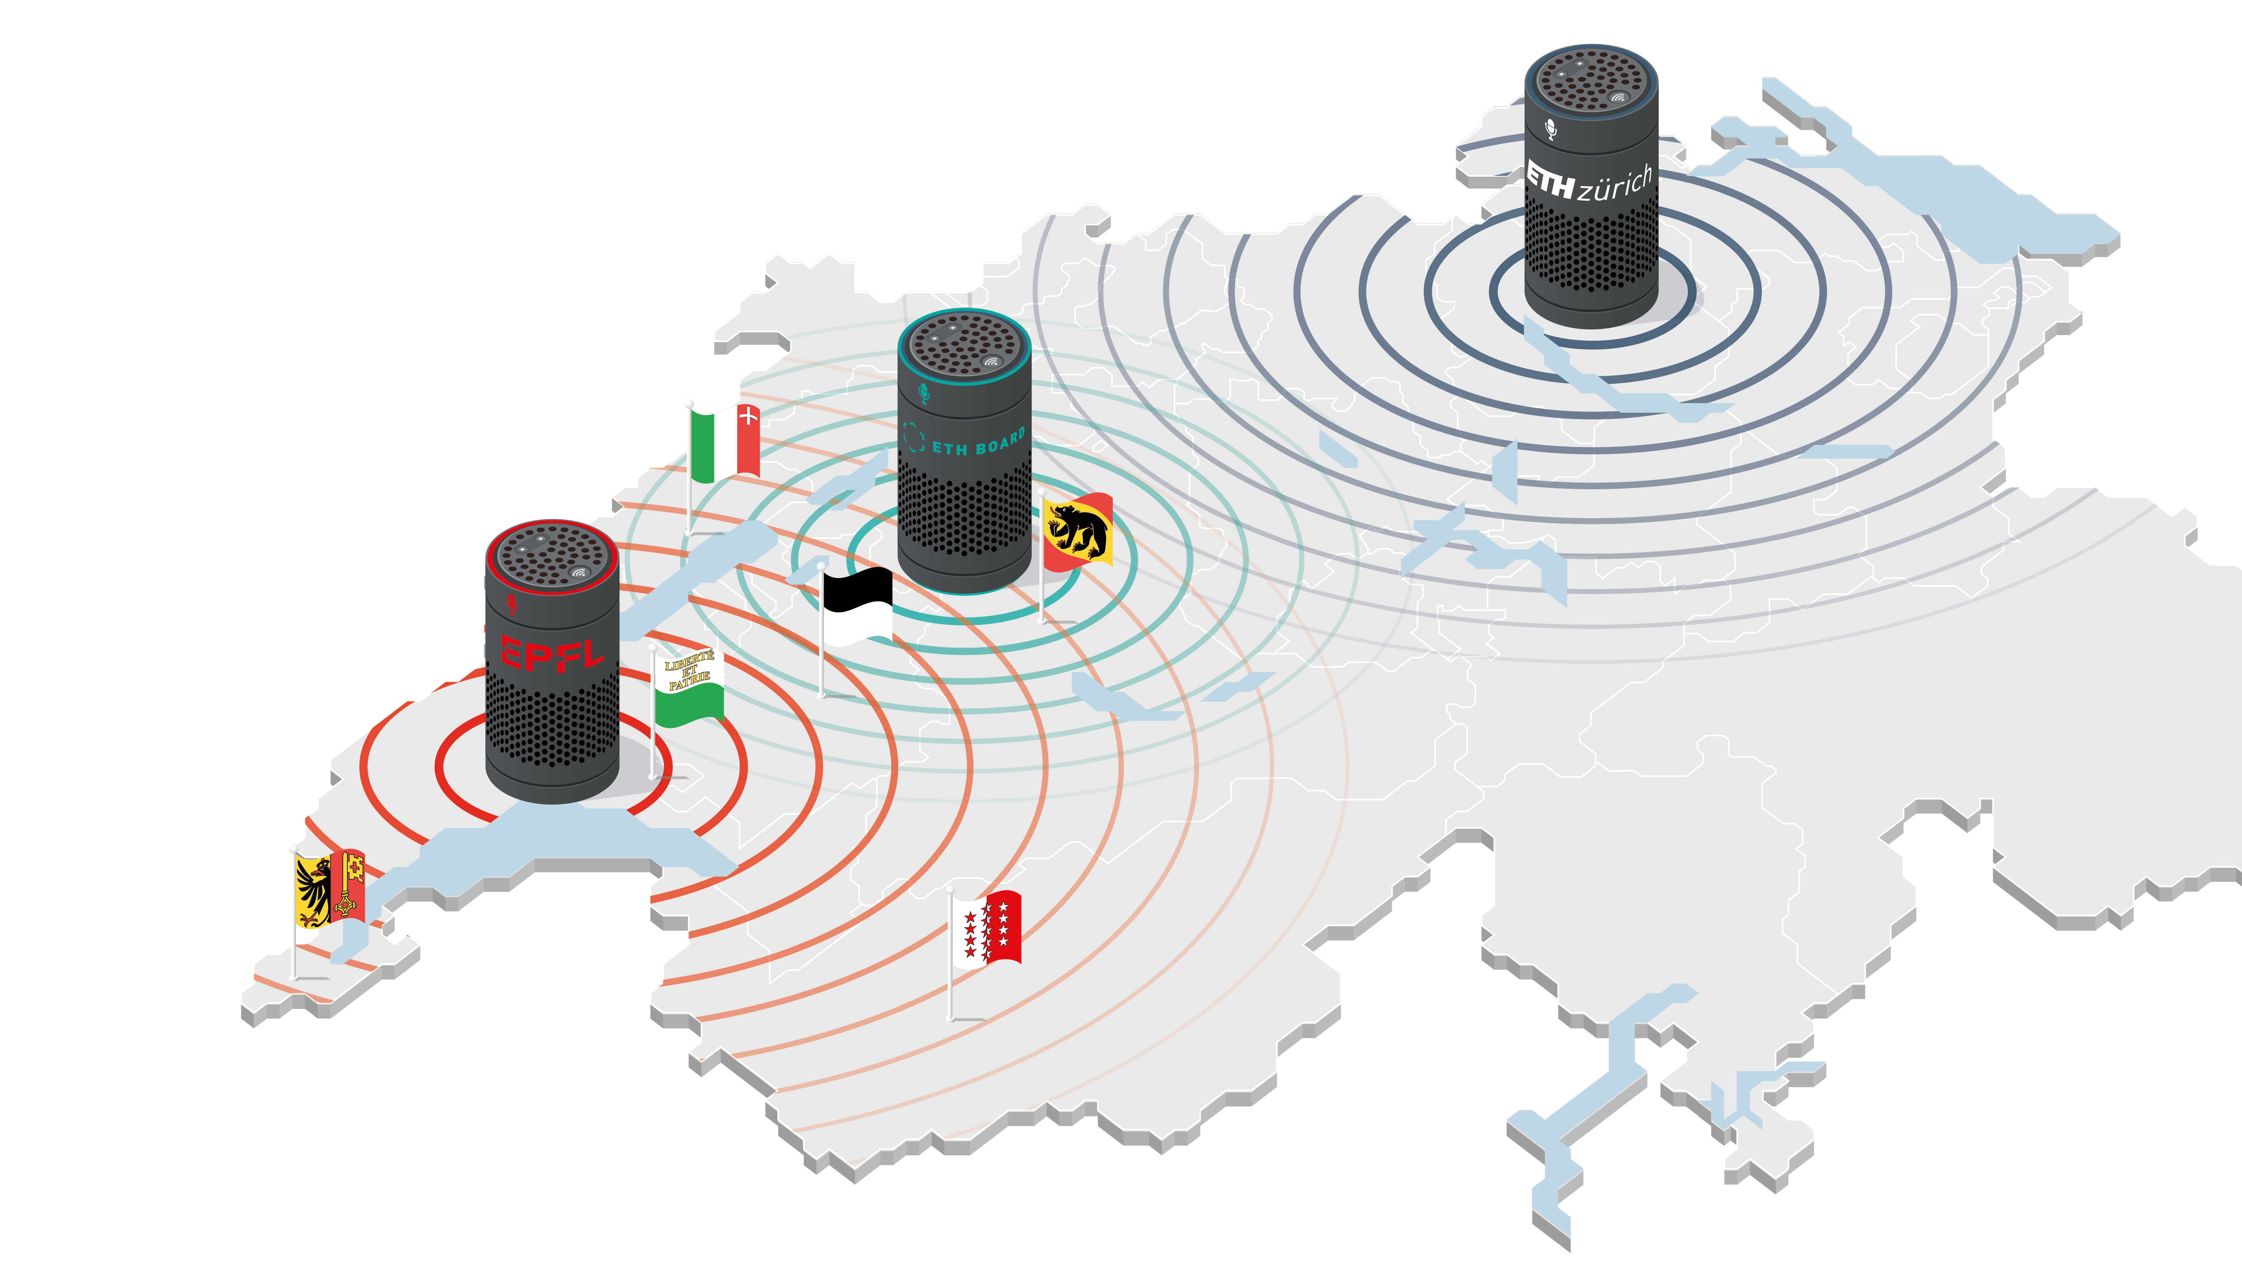
Political aspect
The actors:
ETH Domain
The federal departments
The political world
(Cantons and cities)
Umbrella organisations
Notes:
… nous faisons notre maximum pour que notre budget soit maintenu comme prévu: lobbying auprès des cantons, des communes, des partis, des associations professionnelles.
C'est un travail qui est fait au niveau national et coordonné entre les équipes de toutes les entités du domaine des EPFL.
On s'engage à fond pour convaincre du rôle crucial des EPF

Slide 17
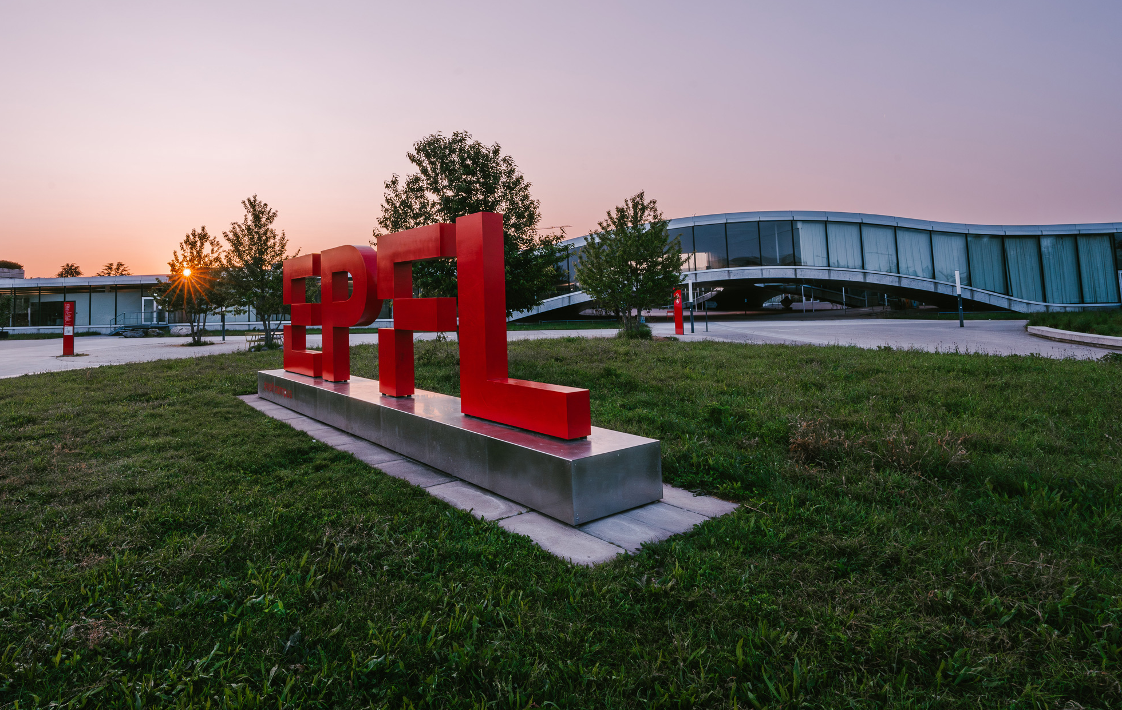
EPFL ASSEMBLY
Thank you !
Martin Vetterli
EPFL President
EPFL – BC 410
02.02.2024

